Slide 1
Bits, Bytes, Ints
Jinyang Li
Some slides are due to Tiger Wang

Slide 2
Lesson plan
How computers represent integers in binary formats
Bit, Byte
How to make binary formats readable to humans
Hex notation
How computers add/subtract integers
Unsigned vs. signed integer representation

Slide 3
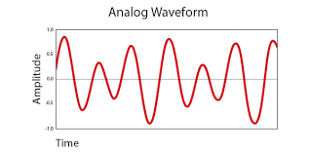

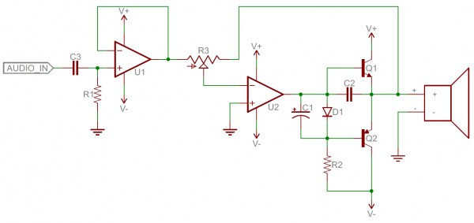
The language of technology has evolved from analog signals…
Analog signals: smooth and continuous
Hard
Difficult to design
Susceptible to noise
Analog components: resistors, capacitors, inductors, diodes, etc.

Slide 4
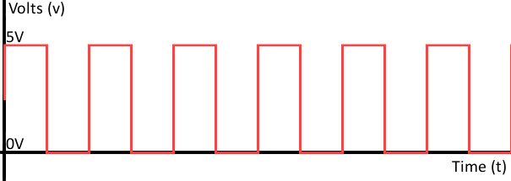

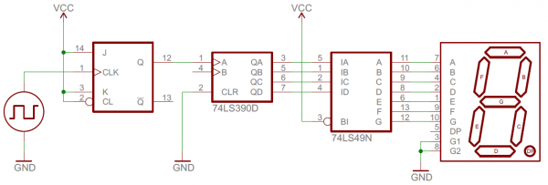
… to digital
1 0 1 0 1 0 1 0 1 0 1 0
Digital signals: discrete (0 or 1)
Easier
Easier to design
Robust to noise
Digital components: transistors, logic gates …

Slide 5
Using bits to represent everything
Bit = Binary digit, 0 or 1
A bit is too small to be useful
A bit has 2 values; the English alphabet has 26 values (characters)
Idea: use a group of bits
different bit patterns represent different “values”

Slide 6
Question
How many bit patterns can a group of 2 bits have?
Can be
either 0 or 1
b₁
b₀
All patterns of 2-bits: 00, 01, 10, 11
How many bit patterns does a group of n bits have?
b_{n-1}b_{n-2}...b₁b₀
# of patterns of n-bits: 2^{n}
n bits

Slide 7
Digression: Any self-respecting CS person must memorize powers of 2
2⁰ = 1
2¹ = 2
2² = 4
2³ = 8
2⁴ = 16
2⁵ = 32
2⁶ = 64
2⁷ = 128
2⁸ = 256
2⁹ = 512
2¹⁰ = 1024

Slide 8
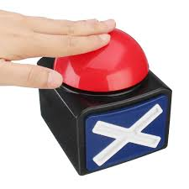
2⁵

Slide 9
2⁸

Slide 10
Approximations of powers of 2
2¹⁰ = 1024
≈
10³ (Kilo)
≈
2²⁰
10^{3*2} = 10⁶ (Mega)
≈
2³⁰
10^{3*3} = 10⁹ (Giga)
≈
2⁴⁰
10^{3*4} = 10¹² (Tera)
≈
2⁵⁰
10^{3*5} = 10¹⁵ (Peta)

Slide 11

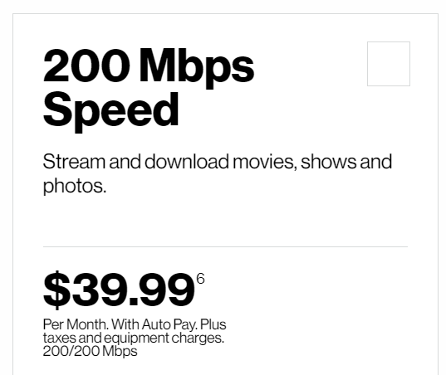
≈ 2??

Slide 12
Represent non-negative integer
unsigned
bits: b₁b₀
Goal: map each bit pattern to an integer
00 → 0
01 → 1
10 → 2
11 → 3
4 patterns
Range: [0, 3]

Slide 13
Represent unsigned integer
Bit pattern: b_{n-1}b_{n-2}…b₂b₁b₀
Range: [0, 2^{n} -1]
Base-2 representation:
b_{n-1}b_{n-2}…b₂b₁b₀ =
b_{i} is bit at i-th position (from right to left, starting at i=0)

Slide 14
Examples
Bit pattern: 00000110
Value: 0*2⁷+0*2⁶+0*2⁵+0*2⁴+0*2³+1*2²+1*2¹+0*2⁰ = 6
Bit pattern: 10000110
Value: ?
Notes:
128+4+2 = 134

Slide 15
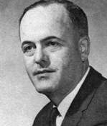
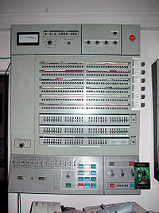
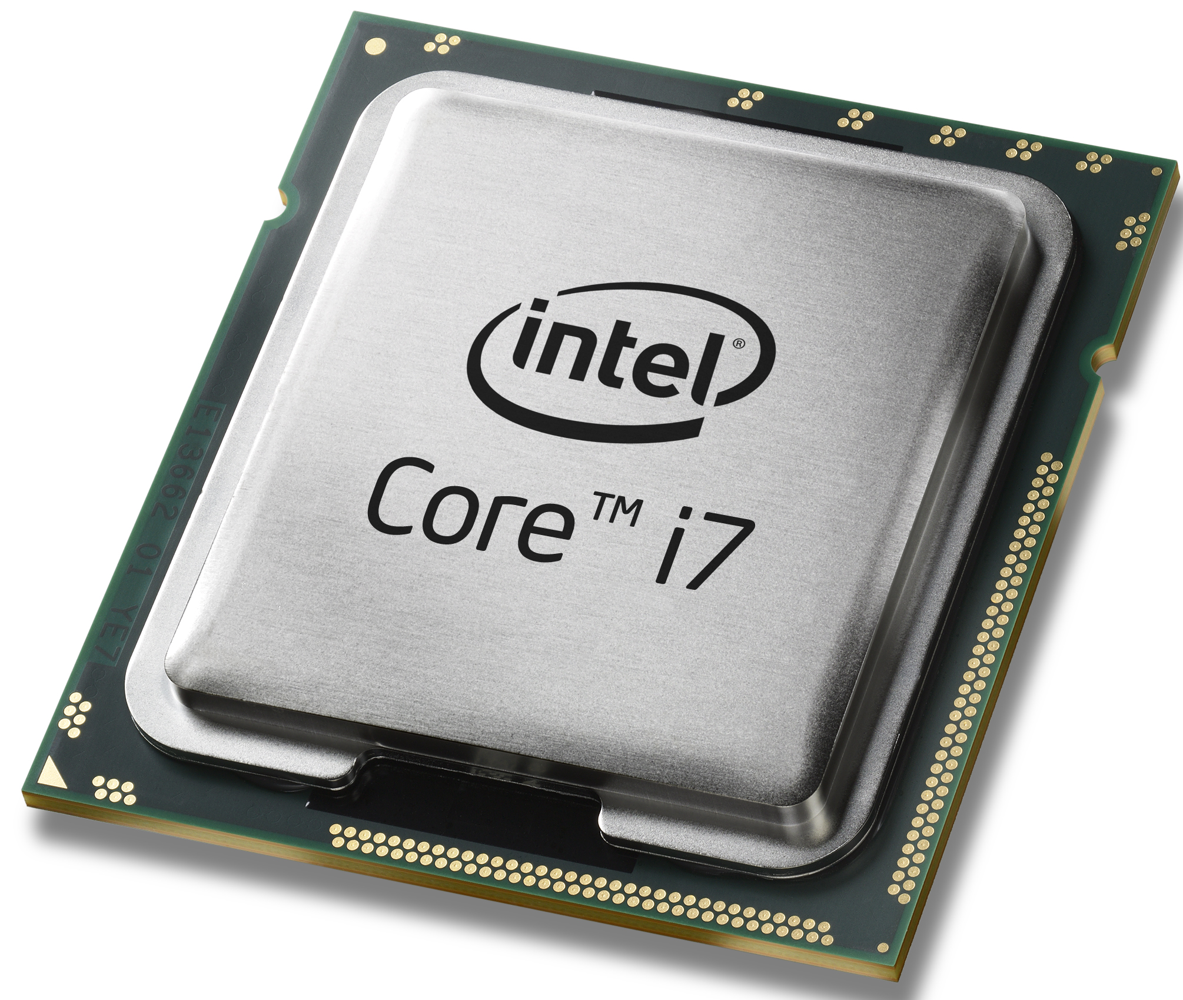
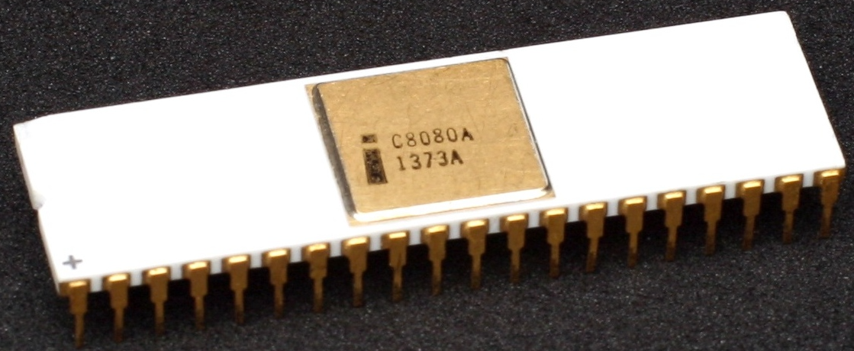
Byte
Byte: a fixed size group of bits
The term is coined by Werner Buchholz (IBM).
Long long ago, different vendors use different byte sizes
Now: Byte is 8-bit
IBM System/360, 1964
Intel 8080, 1974
Modern processors
Introduced 8-bit byte
Widely adopted
Standardized
Notes:
Why byte?

Slide 16
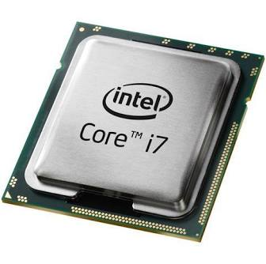
Byte
00011010
00001110
11001010
10101110
00111010
......
Memory
CPU
Byte is the smallest unit of information storage, computation and transfer
Integers are represented by 1,2,4, or 8 bytes.
Notes:
Why byte?

Slide 17
Range of 1-byte non-negative integers: [0, ??]
Bit-pattern of the largest integer?

Slide 18
Range of 4-byte non-negative integers: [0, ??]
Bit-pattern of the largest integer?

Slide 19
Most and least significant bit
MSB: bit position with the largest positional value
LSB: bit position with the smallest positional value
1-byte unsigned int:
10011010
4-byte unsigned int:
01110011 10001101 01010011 11011010
Most significant byte
Least significant byte

Slide 20
Describing bit patterns in a human-readable way
1-byte int: 10101110
C program:
unsigned int a = 0b10101110;
If I ask you to type a 4-byte int, …

Slide 21
Describing a bit pattern: hex notation
10101110
Use one (hex) symbol to represent
a group of 4 bits
How many hex symbols are needed?
Binary | Hex
0000 | 0
0001 | 1
0010 | 2
0011 | 3
0100 | 4
0101 | 5
0110 | 6
0111 | 7
Binary | Hex
1000 | 8
1001 | 9
1010 | a
1011 | b
1100 | c
1101 | d
1110 | e
1111 | f
C program:
unsigned int a = 0xae;

Slide 22

Breakout time!

Slide 23
Breakout exercises
What's the least significant bit of any even number?
Write the hex notation of this 2-byte bit pattern: 1111000011000011
What's the decimal value of unsigned int: 0xff
0
0xf0c2
255

Slide 24
What have we learnt
How computers represent integers
Bit, Byte
Hex notation
Q: What is 10001111 in decimal?
A: 143
Q: What's the least significant bit of any even number?
Q: What is 10001111 in hex?
A: 0x8F

Slide 25
Lesson plan
How computers represent integers
Bit, Byte
Hex notation
How computers add/subtract integers
Signed integer representation
2’s complement
A short history of processors:
from 8-bit to 64-bit machines
Byte ordering: big vs. small endian

Slide 26



Unsigned int addition
0 0 0 0 1 0 1 1
1 0 0 0 1 0 1 1
+
0 0 0 0 1 0 1 0
+
1 0 0 0 1 0 1 0
0 0 0 1 0 1 0 1
0 0 0 1 0 1 0 1
Grade school
method
Overflow!

Slide 27
Unsigned int subtraction
0 0 0 0 1 1 1 0
0 0 0 0 1 0 1 0
-
0 0 0 0 1 0 1 1
-
0 0 0 0 1 0 1 1
0 0 0 0 0 0 1 1
???
🤔
How to represent
negative numbers?
Grade school
method

Slide 28

Represent negative numbers: a strawman
Most significant bit (MSB) represents the sign
0 0 0 0 0 0 0 1₂
1
sign
magnitude
1 0 0 0 0 0 0 1₂
-1
0 0 0 0 0 0 0 1
+
1 0 0 0 0 0 0 1
-2 ???
1 0 0 0 0 0 1 0
☹Need different h/w for signed
vs. unsigned computation

Slide 29
Two’s complement
Unsigned int
00010110
= 0*2⁷ + 0*2⁶ + 0*2⁵ + 1*2⁴ + 0*2³ + 1*2² + 1*2¹ + 0*2⁰
10010110
= 1*2⁷ + 0*2⁶ + 0*2⁵ + 1*2⁴ + 0*2³ + 1*2² + 1*2¹ + 0*2⁰
Signed int
00010110
= 0*(-2⁷) +0*2⁶ +0*2⁵ +1*2⁴ +0*2³ +1*2² +1*2¹+0*2⁰
10010110
= 1*(-2⁷) +0*2⁶ +0*2⁵ +1*2⁴ +0*2³ +1*2² +1*2¹+0*2⁰

Slide 30
Two’s complement
1-byte bit pattern → signed int
Bit pattern | value
00000000 | 0
00000001 | 1
… | …
01111111 | 2⁷-1 = 127
10000000 | -2⁷ = -128
10000001 | -2⁷ +1= -127
…
11111111 | -2⁷+(2⁷-1) = -1

Slide 31
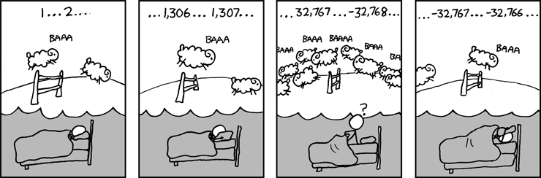
Two’s complement
?-byte bit pattern → signed int
Source: xkcd.com

Slide 32
Basic facts of 2’s complement
Signed int
Size (bytes) | Bit pattern of smallest | Bit pattern of largest | Range
1
2
4
8
0x80 | 0x7f | [-2⁷, 2⁷-1]
0x8000 | 0x7fff | [-2¹⁵, 2¹⁵-1]
0x80000000 | 0x7fffffff | [-2³¹, 2³¹-1]
0x8000000000000000 | 0x7fffffffffffffff | [-2⁶³, 2⁶³-1]
🤔 Home exercise: make a similar table for unsigned int
Negative numbers ←→ MSB=1
A sequence of 1’s (e.g. 0xff, 0xffffffff) ←→ -1

Slide 33
Two’s complement: 8-bit signed integer
01011000
= 0*(-2⁷) +1*2⁶ +0*2⁵ +1*2⁴ +1*2³ +0*2² +0*2¹+0*2⁰ = 88
11011000
= 1*(-2⁷) +1*2⁶ +0*2⁵ +1*2⁴ +1*2³ +0*2² +0*2¹+0*2⁰ = -40
00000000
= 0
11111111
= -1
10000000
= -2⁷= -128
01111111
= 2⁷-1= 127

Slide 34
2’s complement: find a number’s negation
00101000
??
(40)₁₀
(-40)₁₀
A useful trick to do negation:
Step-1: flip all bits
00101000
(40)₁₀
Step-1: flip bits
Step-2: add 1
11010111
Step-2:
+00000001
11011000
(-40)₁₀

Slide 35
Why does the negation trick work
b with bits flipped

Slide 36
Using negation trick to find the bit-pattern of a negative number
The bit pattern of 8-bit signed integer -33?
Answer:
33 = (00100001)₂
Apply negation trick: (11011110)₂+1=(11011111)₂

Slide 37
Negation trick helps computers do subtraction
Instead of doing this:
Do this instead:
0 0 0 0 0 1 0 0
(4)₁₀
0 0 0 0 0 1 0 0
(4)₁₀
(3)₁₀
-
0 0 0 0 0 0 1 1
(3)₁₀
1 1 1 1 1 1 0 0
(-3)₁₀
0 0 0 0 0 0 1 1
+
0 0 0 0 0 0 0 1
(1)₁₀
0 0 0 0 0 0 0 1
(1)₁₀
0 0 0 0 0 0 0 1
Works for both unsigned and signed subtraction!

Slide 38
Unsigned addition
🤔
0 0 0 0 0 0 0 1
(1)₁₀
(3)₁₀
0 0 0 0 0 0 0 1
(1)₁₀
(129)₁₀
+
+
0 0 0 0 0 0 1 1
1 0 0 0 0 0 0 1
(4)₁₀
(130)₁₀
0 0 0 0 0 1 0 0
1 0 0 0 0 0 1 0
0 1 0 0 0 0 0 1
(65)₁₀
(64)₁₀
1 0 0 0 0 0 0 1
(129)₁₀
(254)₁₀
+
+
1 1 1 1 1 1 1 0
0 1 0 0 0 0 0 0
(129)₁₀
(127)₁₀
1 0 0 0 0 0 0 1
0 1 1 1 1 1 1 1
Overflow!

Slide 39
Signed addition
🤔
0 0 0 0 0 0 0 1
(1)₁₀
(3)₁₀
0 0 0 0 0 0 0 1
(1)₁₀
(-127)₁₀
+
+
0 0 0 0 0 0 1 1
1 0 0 0 0 0 0 1
This is what 2’s complement is designed to accomplish!
(4)₁₀
(-126)₁₀
0 0 0 0 0 1 0 0
1 0 0 0 0 0 1 0
0 1 0 0 0 0 0 1
(65)₁₀
(64)₁₀
1 0 0 0 0 0 0 1
(-127)₁₀
(-2)₁₀
+
+
1 1 1 1 1 1 1 0
0 1 0 0 0 0 0 0
(-127)₁₀
(127)₁₀
1 0 0 0 0 0 0 1
0 1 1 1 1 1 1 1
Overflow!
Overflow!

Slide 40
Unsigned subtraction
🤔
0 0 0 0 0 0 0 1
(1)₁₀
(3)₁₀
0 0 0 0 0 0 0 1
(1)₁₀
(255)₁₀
-
-
0 0 0 0 0 0 1 1
1 1 1 1 1 1 1 1
(254)₁₀
(2)₁₀
1 1 1 1 1 1 1 0
0 0 0 0 0 0 1 0
Overflow!
Overflow!
0 1 1 1 1 1 1 1
(127)₁₀
(254)₁₀
1 0 0 0 0 0 0 0
(128)₁₀
(1)₁₀
-
-
0 0 0 0 0 0 0 1
1 1 1 1 1 1 1 0
(129)₁₀
(127)₁₀
1 0 0 0 0 0 0 1
0 1 1 1 1 1 1 1
Overflow!

Slide 41
Signed subtraction
🤔
0 0 0 0 0 0 0 1
(1)₁₀
(3)₁₀
0 0 0 0 0 0 0 1
(1)₁₀
(-1)₁₀
-
-
0 0 0 0 0 0 1 1
1 1 1 1 1 1 1 1
(-2)₁₀
(2)₁₀
1 1 1 1 1 1 1 0
0 0 0 0 0 0 1 0
0 1 1 1 1 1 1 1
(127)₁₀
(-2)₁₀
1 0 0 0 0 0 0 0
(-128)₁₀
(1)₁₀
-
-
0 0 0 0 0 0 0 1
1 1 1 1 1 1 1 0
(-127)₁₀
(127)₁₀
1 0 0 0 0 0 0 1
0 1 1 1 1 1 1 1
Overflow!
Overflow!

Slide 42
Lesson plan
How computers represent integers
Bit, Byte
Hex notation
How computers add/subtract integers
Signed integer representation
2’s complement
A short history of processors:
from 8-bit to 64-bit machines
Byte ordering: big vs. small endian

Slide 43
The evolution of integer sizes in processors

Slide 44
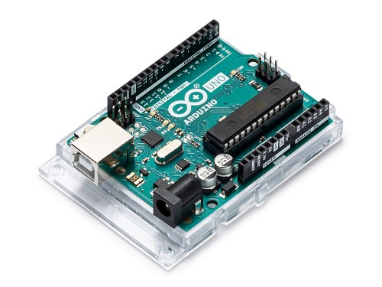
8-bit processors: Intel 8080 (1974)
0xb0
0x0f
CPU
0xa9
0xaf
Arithmetic Logic
Unit
0xa8
0x1e
0xa7
0x4c
0x4c
registers
0x4c
0xa6
0xea
0xa5
0xcb
8 bits machine: 8 bits length of
CPU register
Memory address
0xa4
0xba
0xa3
0x00
0xa2
0xff
0xa1
0x8c
…
……
Memory
Nowadays: 8-bit processor (microcontroller)
Is used for embedded systems

Slide 45
32-bit processors: Intel 386 (1985)
0x000000b0
0x0f
CPU
0x000000a9
0xaf
Arithmetic Logic
Unit
0x000000a8
0x1e
0x000000a7
0x4c
0x4c1eaf0f
registers
0x4c1eaf0f
0x000000a6
0xea
0x000000a5
0xcb
0x000000a4
0xba
0x000000a3
0x00
32 bits machine: 32 bits length of
CPU register
Memory address
0x000000a2
0xff
0x000000a1
0x8c
…
……
Memory
Most commonly used desktop/server processors
in the latest 80s to early 00s

Slide 46
64-bit processors: Intel Pentium 4 (2000)
0x00…00b0
0x0f
CPU
0x00…00a9
0xaf
0x00…00a8
0x1e
Arithmetic Logic Unit
0x00…00a7
0x4c
registers
0x00bacbea4c1eaf0f
0x00…00a6
0xea
0x00…00a5
0xcb
0x00bacbea4c1eaf0f
0x00…00a4
0xba
0x00…00a3
0x00
64 bits machine: 64 bits length of
CPU register
Memory address
0x00…00a2
0xff
0x00…00a1
0x8c
…
……
Memory
Nowadays:
Servers/laptops: Intel/AMD 64-bit x86 processors
Mobile phones/tablets: 64-bit ARM processors (made by Apple/Qualcomm/Samsung etc)

Slide 47
C’s Integer data types on 64-bit machine
 | Length | Min | Max
char | 1 byte | -2⁷ | 2⁷ - 1
unsigned char | 1 byte | 0 | 2⁸ - 1
short | 2 bytes | -2¹⁵ | 2¹⁵ - 1
unsigned short | 2 bytes | 0 | 2¹⁶ - 1
int | 4 bytes | -2³¹ | 2³¹ - 1
unsigned int | 4 bytes | 0 | 2³² - 1
long | 8 bytes | -2⁶³ | 2⁶³ - 1
unsigned long | 8 bytes | 0 | 2⁶⁴ - 1

Slide 48
Your first C program
#include <stdio.h>
int
main()
{
char x = -127;
char y = 0x81;
char z = x + y;
printf(“hello world sum is %d\n”, z);
}
$ gcc helloworld.c
$ ./a.out
1 0 0 0 0 0 0 1
-127
+
1 0 0 0 0 0 0 1
-127
1
0 0 0 0 0 0 1 0
2

Slide 49
Memory layout for multi-byte integers
0x00…00b0
CPU
0x00…00a9
0x00…00a8
Arithmetic Logic Unit
0x00…00a7
registers
0x00…00a6
0x00…00a5
0x00…00a4
4-byte
0x00…00a3
0x00…00a2
0x00…00a1
…
……
Memory

Slide 50
Memory layout: Little Endian
int x = 0x12345678
CPU
Arithmetic Logic Unit
registers
0x12 | 0x34 | 0x56 | 0x78
addr+3
0x12
addr+2
0x34
addr+1
0x56
x:
addr
0x78
……
Little endian:
Least significant byte stored at smallest address
Used in x86 processors (servers/laptops) and most ARM (phones/tablets) implementation
address of x
Memory

Slide 51
Advantage of Little Endian
0x12345678
+
Processor performs calculation
from the least significant bit
0x12131415
Processor can simultaneously
perform memory transfer and
calculation.

Slide 52
Another advantage of Little Endian
CPU
Arithmetic Logic Unit
registers
…
addr+3
0x12
int a = 0x12345678;
addr+2
0x34
short b = (short)a;
addr+1
0x56
b:
a:
addr
0x78
Casting a larger integer to a smaller one requires no explicit conversion.
…
……
Memory

Slide 53
Memory layout: Big Endian
int a = 0x12345678;
CPU
Arithmetic Logic Unit
registers
0x12 | 0x34 | 0x56 | 0x78
…
addr+3
0x78
addr+2
0x56
addr+1
0x34
a:
addr
0x12
…
……
Big Endian:
Most significant byte stored at smallest address
ARM processors (phones/tablets) in principle support both endian
Memory

Slide 54
Advantages of Big Endian
Quick to test whether the number is positive or negative
Examine byte stored at the address offset zero.

Slide 55
Big or Little Endian?
#include <stdio.h>
int main()
{
int x = 0x05060708;
int *p;
p = &x; //p contains the address of x
char y = *(char *)p; //y is the 1-byte value pointed to by p
printf(“y=%d\n”, y);
}
$ gcc endian.c
$ ./a.out

Slide 56
Summary
Integer representation
Unsigned (base-2)
Signed (2’s complement)
Hex notation
Operations (e.g. add,subtract) on fixed-width integers can cause overflow
Big vs. little endian

